Slide 1

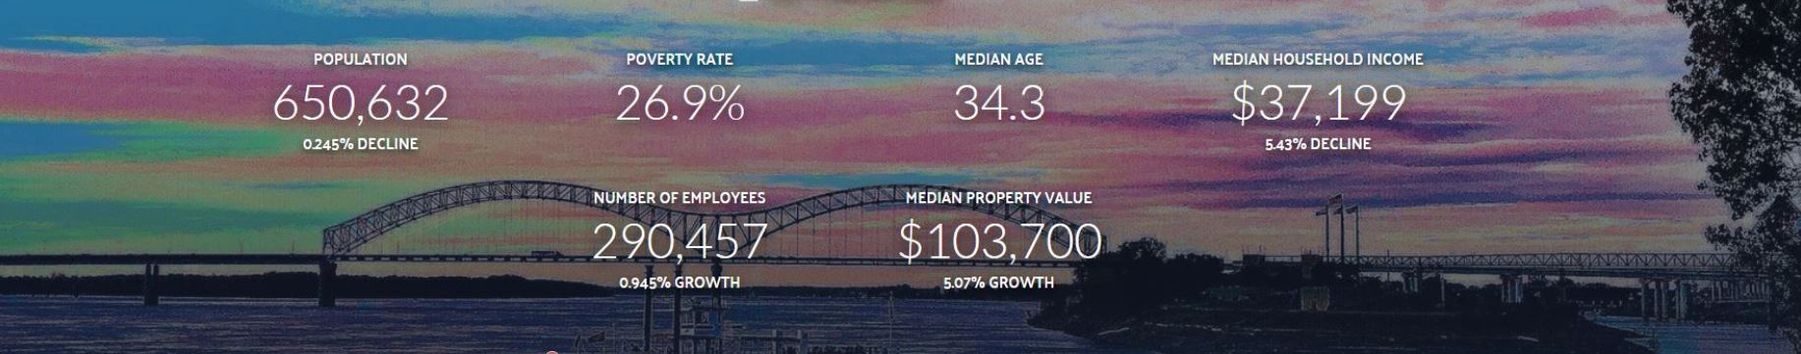
Coursera - IBM Professional Certificate - Applied Data Science Capstone Project
Title of the project : Aerial view - venues mapping support system
By Geetha Narayanan

Slide 2
Introduction
Introduction / Background :Catalyst LLC is a new start-up company in Memphis, Tennessee, USA which provides support services to tourists and visitors as well as aiding to conduct personal/professional events and functions.
Catalyst LLC has a plan to have a support system for selected option by the customer who likes to explore the city.
As a quick-win proto project, residential City of Memphis taken as a geo-location and through the coding in Python with the help of Coursera-IBM Skill lab and GitHub working out a proposal.

Slide 3
About Memphis city
MEMPHIS is a city located in Tennessee, United States of America. The city population was 650,618 in 2018.Memphis is the 26th largest city out of 314 US cities.
Memphis is one of the leading commercial centers in transportation and logistics. Memphis international airport is the second busiest cargo airport in the world and the international port of Memphis is the fifth busiest inland water port in America.
As on date, Memphis is a regional center for commerce, education, media, art, music and entertainment.
(Note: Two memorable places in Memphis are : 1. King of rock and roll – singer and actor Elvis Presley’s and 2. The Noble Peace Prize 1964 winner for non-violence and Leader - Martin Luther King Jr.’s.)
(P.S) Interesting to also note that each and every FedEx air package in US goes through Memphis, though there are direct routes.

Slide 4
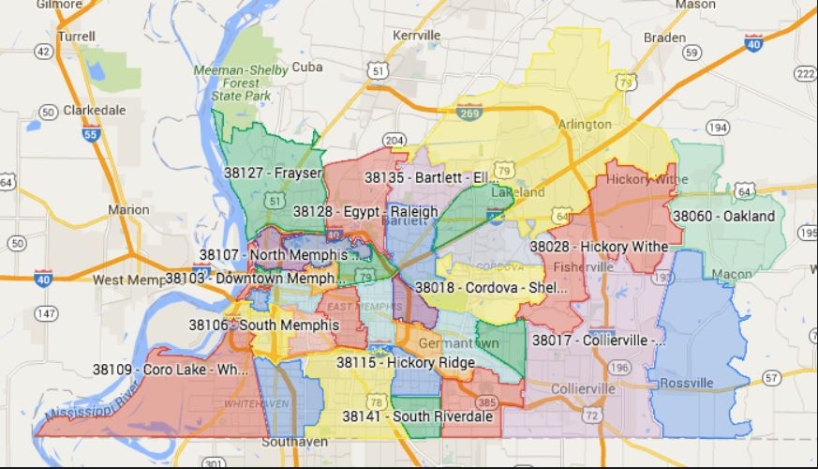
Memphis map – with Postal Codes

Slide 5
Objective, Scope & Target:
Objective: The objective of this project is to provide management and users to view list of combined venues like food centers, cafeteria, fun place, Nightlife & Top pick of our choice in the selected city together with their geo-spatial data or through an aerial map to save their decision support and saving their time by avoiding one by one search.
Scope: Starting with one city – Memphis but can be deployed with multiple cities optional selection by clustering in next phase, after quick-win of the project. Other Tennessee cities (e,g) like Nashville (First largest) and Knoxville( Third largest ) may also be included by including their address 2 and 3 as shown in Python Jupyter note book – row #
Target : Users includes not only of our company management person but also mainly our customers and public on need (i.e) exploring different places or similar places.

Slide 6
Data Description
1. The data used in the project is obtained from FOURSQUARE API. By using Explorer, data collected for café, restaurant, fun, nightlife , etc., for multiple searches.
Link: https://foursquare.com/
2. For the city data: Latitude: 35.122864,Longitude: 89.951860,Population: 729,307,Area: 391.55 sq. miles, Land: 386.69 sq. miles, Water: 4.86 sq. miles, Population Density: 1,886.02 people per sq. mile,- Elevation: 273.0 feet above sea level . Time Zone: Central (GMT -6)
Link: https://en.wikipedia.org/wiki/Memphis,_Tennessee
https://en.wikipedia.org/wiki/List_of_neighborhoods_in_Memphis,_Tennessee
https://en.wikipedia.org/wiki/Category:Neighborhoods_in_Memphis,_Tennessee
https://en.wikipedia.org/wiki/List_of_United_States_cities_by_population
https://open311.memphistn.gov/#!/view-data
https://www.fedex.com/en-us/about/policy/aviation/why-memphis.html
3. For Choropleth maps , geojson file of Memphis used.
4.Python Folium library will be used to visualize the venues & allied clusters.

Slide 7
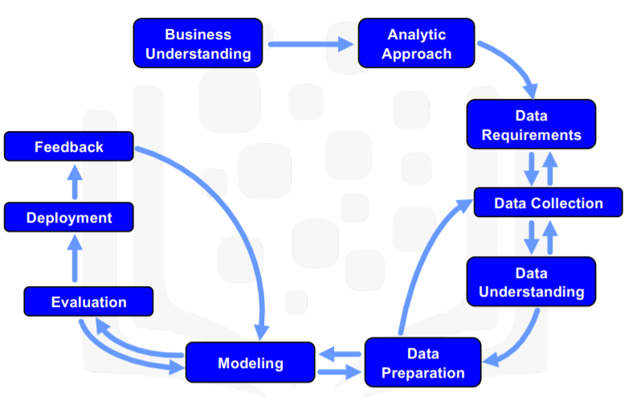
Methodology : Learning IBM Model-CRISP
CRISP (Cross Industries Standard Process) through Coursera :
Remember: Above 10 steps are need not to be followed strictly in a sequence (i.e) a flexible and iterative approach- (seq optional).

Slide 8
Coverage :
Venues geo mapping :
Food, Cafeteria, Breakfast, Restaurants, Fun-Gym, Park, Nightlife & Top pick-Museum
The following questions are to be attempted:
1.How many places or venues under each category?
2. How many similar venues exist and its’ specialty ?
3. How to get ‘Birds eye view’ of their locations ?

Slide 9
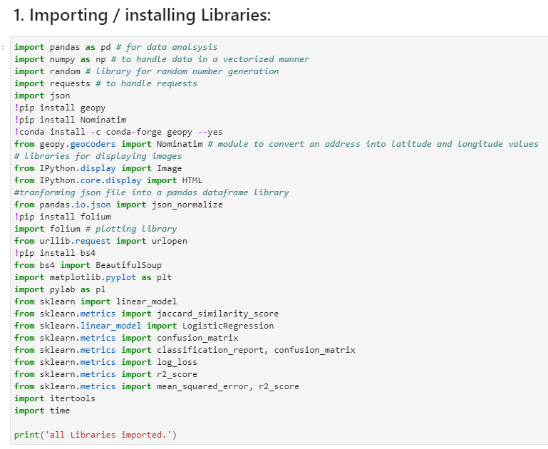
Importing Libraries

Slide 10
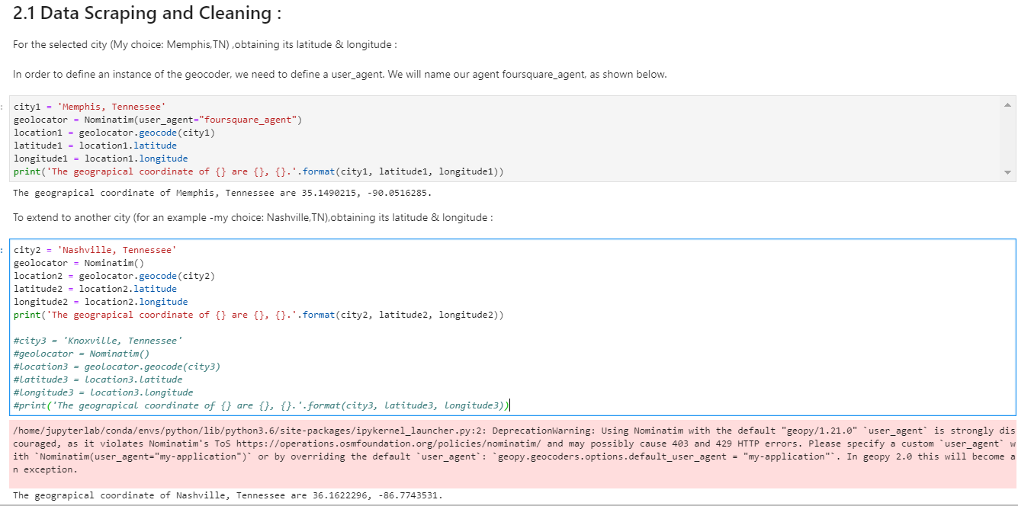
Data Wrangling – URL tried for multi-cities

Slide 11
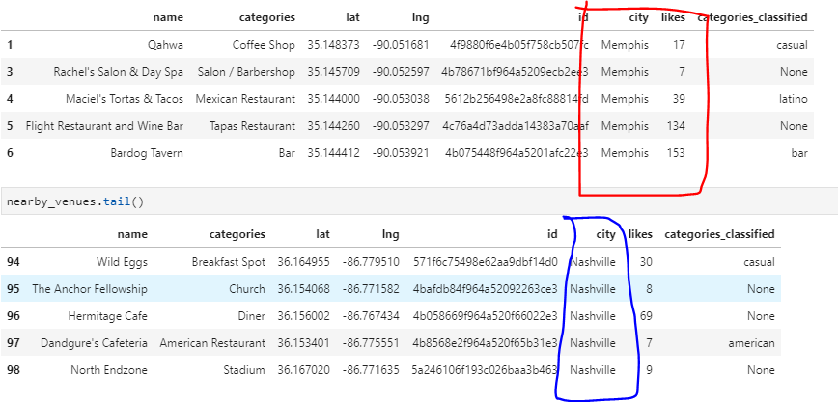
Feasibility-2 cities data merge

Slide 12
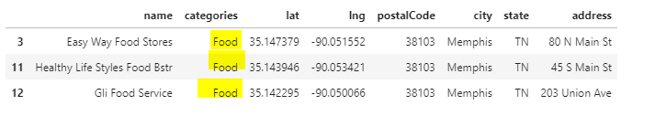
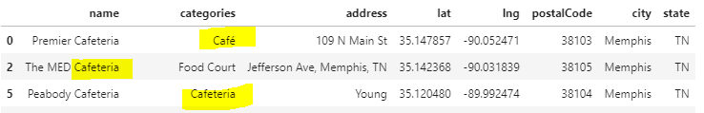
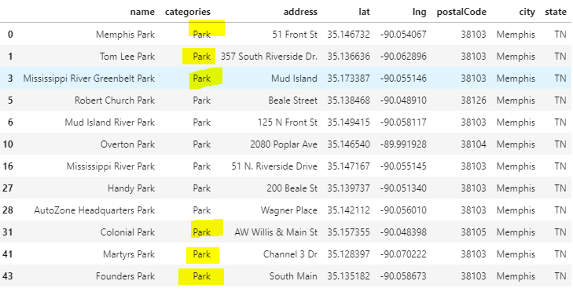
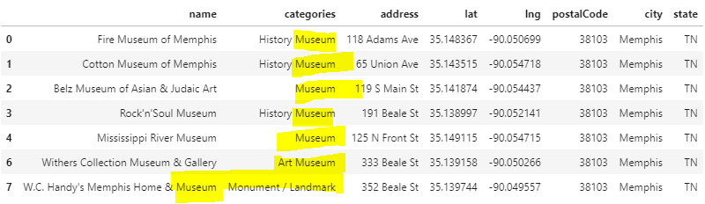
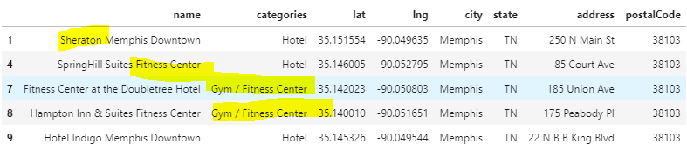
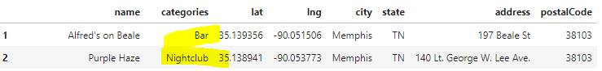
Data Extraction – Various search inputs-after cleaning

Slide 13
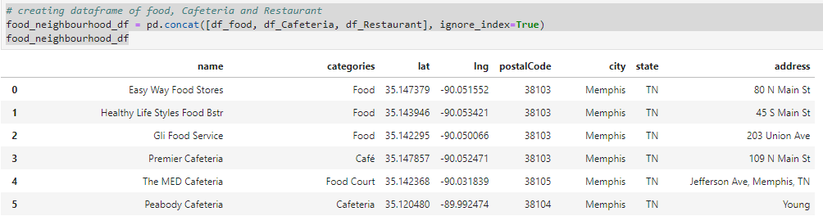
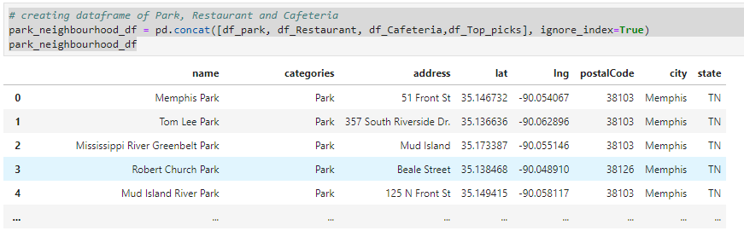
1. Food cluster & 2. Park cluster

Slide 14
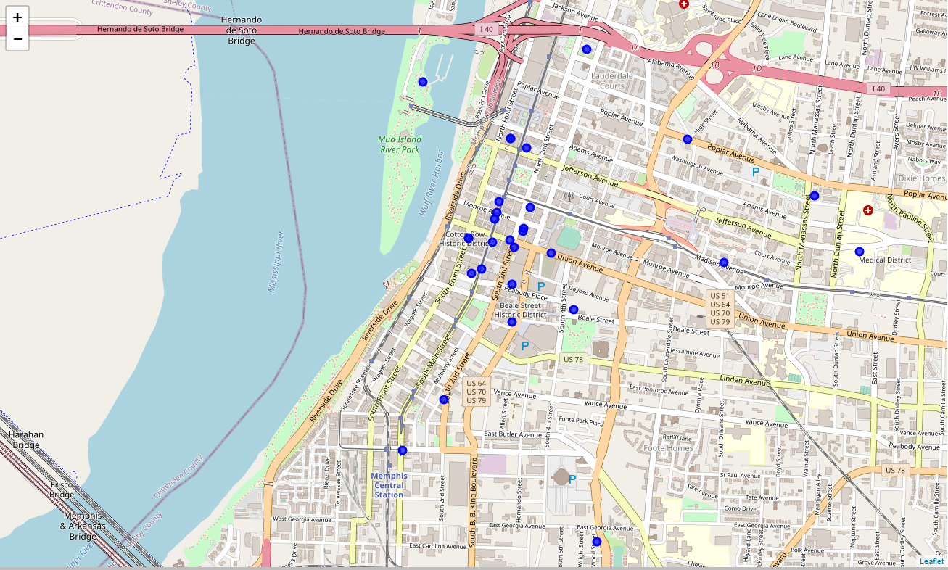
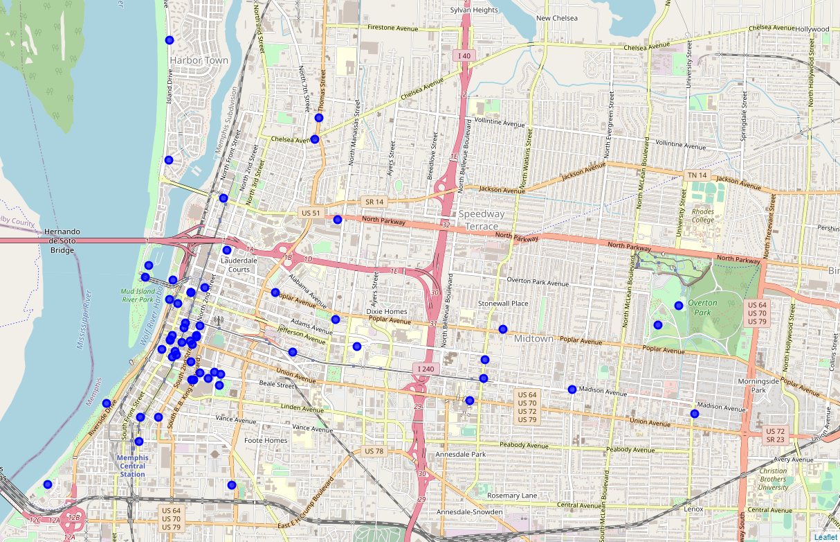
3.Clustering: Creating aerial / geographical location map view-for multi clusters combination
3.1 Cluster 1: Food-Combining Food, Cafeteria and Restaurant venues
3.2 Cluster 2: Park- Combining Park, Restaurant, Cafeteria and Top Pick venues

Slide 15
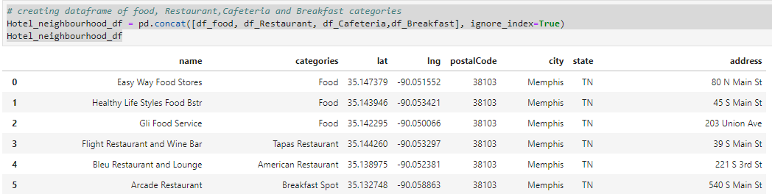
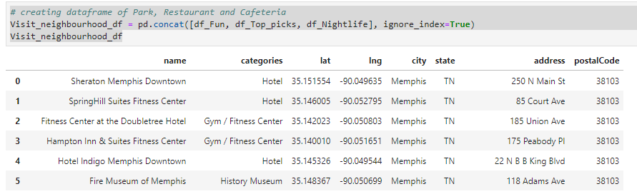
3. Hotel cluster & 4. Visit cluster

Slide 16
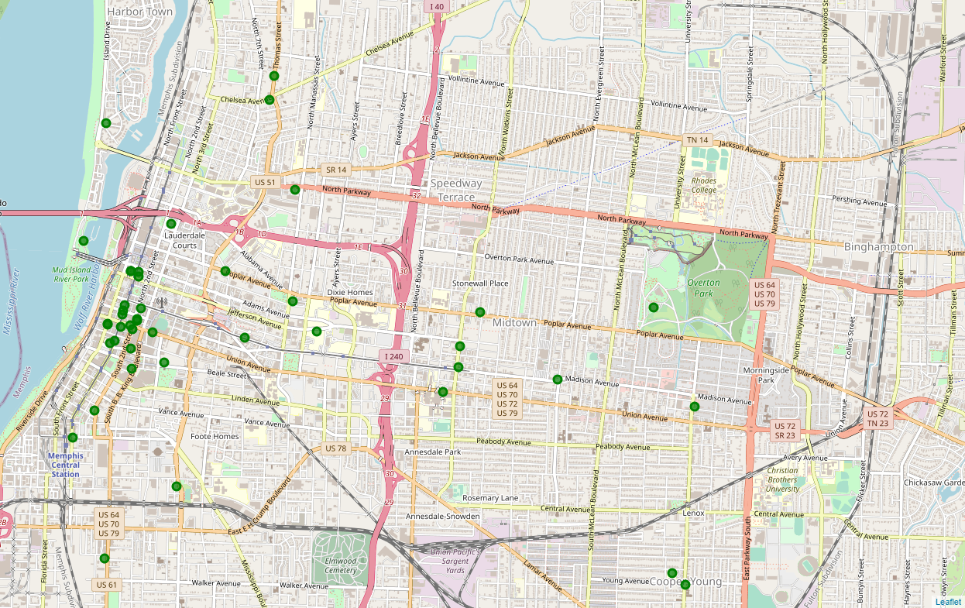
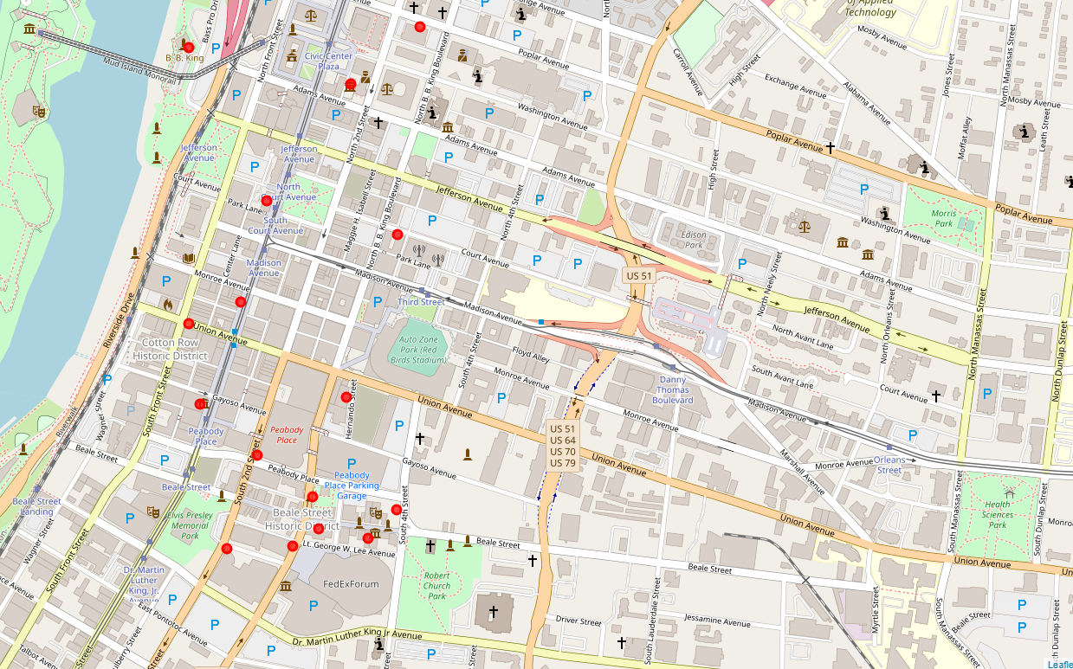
3.Clustering: Creating aerial / geographical location map view-for multi clusters combination
3.3 Cluster 3: Hotel- Combining Food, Restaurant, Cafeteria and Breakfast venues:
3.4 Cluster 4: Visit-Combining Fun-Gym/Fitness center, Top Pick-Museum and Nightlife venues :

Slide 17
4.Conclusion:
Above exercise carried out as a pilot clustering and view with combined option for one city, keeping in mind that to be extended with multi cities combination or for comparison for user need for quicker overall view and decision. ( In 2.1 - we had created for 2 cities as an example with url1 & url2 , but 2.2 onwards for easier working , url1 used as url only but with same latitude & longitude )
4.1 Assumption :
Though the exercise limited with clustering concept with four square API and we will be noticing that initially all libraries are imported viz., k-means, Linear model, Logistic Regression, iteration tool, time etc.,

Slide 18
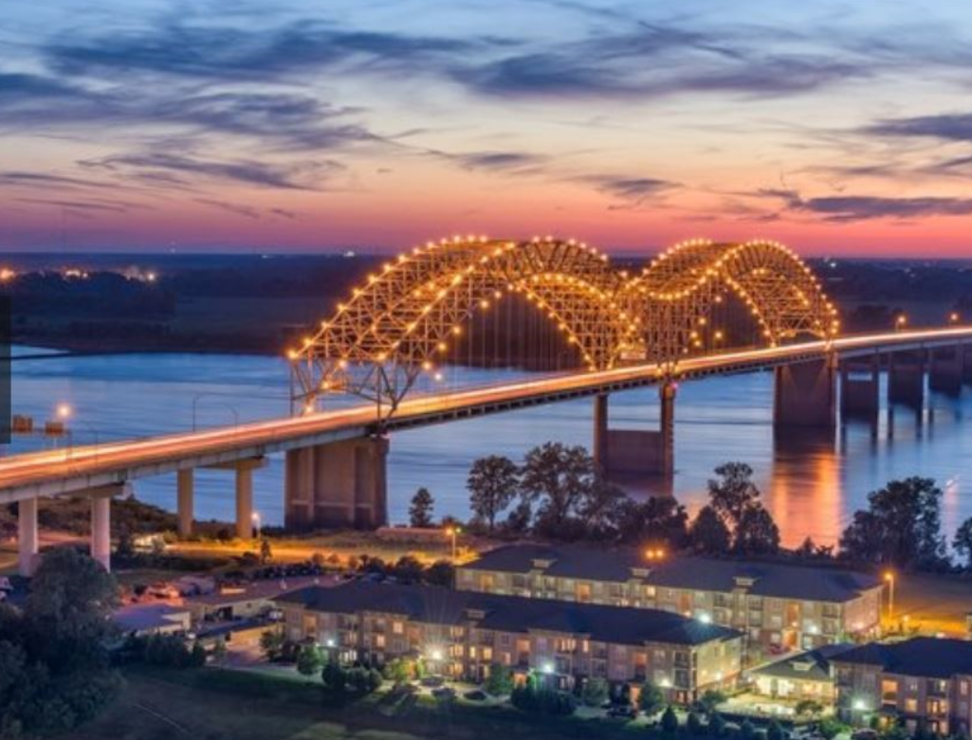
Thanks to all peers and Instructors ! - Geetha Narayanan

